Slide 1
A Line in the Sand
Pat Roy and Mark Rasche of the Institute for Creation Research present…
Notes:
(This presentation was developed by ICR associates Pat Roy and Mark Rasche for use in lectures on biblical creation. The note text is sample verbiage to use as narration with the Power Point images. It may be altered or augmented as needed.)
The issue of a young earth really is a battle over the authority of God's Word. A war is being waged against God's account of Genesis. The enemy's tactic has been the same from the very beginning. Talking to Eve, Satan questioned the meaning of God's words. And today he continues the very same by questioning the creation account. He asks, “is it true what God has said?” If Genesis falls, then the rest of the Bible falls! In Genesis we learn of the creation of all things; the literal fall into sin; the reason for the curse on creation; the entrance of sin, death, and suffering; and about the coming Savior. If these things are not literally true, then we have cause to question the rest of Scripture.
But the war against Genesis hasn't been a direct attack, rather a subtle one. Like the original lie by Satan, there have been those who have questioned the plain meaning of God's Word. Using man's scientific theories and human logic, they've invented new interpretations of Genesis to supposedly fix scientific errors in God's Word. Somewhere along the line, we quit asking what God was really saying, and instead choose the theory we think best fits the evidence. And now Christians have become confused over the issue. Many have adopted the stance that there are so many theories about creation, that no one will really know until we get to eternity. Do you see how the enemy is winning the war? He's simply turned the whole thing into a non-issue. So it's been reduced to a choice about your favorite flavor of creation theory -- just like picking your favorite flavor of ice-cream. It doesn't really matter -- it's just a personal choice.

Slide 2
It was Preparation Day (that is, the day before the Sabbath). So as evening approached, ⁴³Joseph of Arimathea, a prominent member of the Council, who was himself waiting for the kingdom of God, went boldly to Pilate and asked for Jesus' body. ⁴⁴Pilate was surprised to hear that he was already dead. Summoning the centurion, he asked him if Jesus had already died. ⁴⁵When he learned from the centurion that it was so, he gave the body to Joseph. ⁴⁶So Joseph bought some linen cloth, took down the body, wrapped it in the linen, and placed it in a tomb cut out of rock. Then he rolled a stone against the entrance of the tomb. ⁴⁷Mary Magdalene and Mary the mother of Joses saw where he was laid.
- Mark 15:42-47
Notes:
As an analogy, I'd like to share a new theory about the death, burial, and resurrection of Christ called the Protracted Resurrection Theory.
Turn with me to Mark 15:42-47. This is the account just after Christ's death on the cross [read verses above]
Here's my contention concerning this passage. At the beginning of this account it was already evening, and remember, the Sabbath starts at sunset. But look at this long list of things that were supposedly done in between Christ's death and the Sabbath. There wasn't enough time. So I believe these events had to stretch over a few days. In other words, the days during Christ's burial were not actual days, but longer periods of time.

Slide 3
Hemera – Can mean a literal day or period of time
And that he was buried, and that he rose again the third day according to the Scriptures.
- I Corinthians 15:4
And that he was buried, and that he rose again the third hemera according to the Scriptures.
- I Corinthians 15:4
Notes:
But those of you familiar with Scripture may bring up I Corinthians 15:4 which says, “And that he was buried, and that he rose again the third day according to the scriptures:” At first glance this appears to support the idea that it all happened in three literal days. However the original Greek word for “day” in this passage is hemera. And those who study Greek can tell you that hemera can be used to describe a long period of time instead of a literal day. Therefore I propose that the days of the death, burial, and resurrection of Christ were long periods of time, not literal days.
How many of you agree with me? [wait for audience reply]. Frankly, I don't believe it either! But what if I wrote a book on this Protracted Resurrection Theory, and started going on the radio and TV promoting the idea? What if other big name Christian leaders joined me and also wrote books, started ministries and began websites all teaching the Protracted Resurrection Theory? Do you think it could begin to build a following? [wait for audience reply]. Soon churches would begin presenting the Protracted Resurrection Theory alongside the traditional interpretation. Some would begin to feel as if it was a complicated issue, and that we will never really have the answer until we are in eternity.
But none of you believe in my new Protracted Resurrection Theory, do you? [wait for audience reply] That's right, because you know the truth. The Bible makes it clear, “And that he was buried, and that he rose again the third day according to the scriptures.” The meaning is so obvious, that a child could read it and come away with that understanding.

Slide 4
For in six days the LORD made heaven and earth, the sea, and all that in them is, and rested the seventh day: therefore the LORD blessed the sabbath day, and hallowed it.
- Exodus 20:11
Notes:
Now, let me read another verse – Exodus 20:11: “For in six days the LORD made heaven and earth, the sea, and all that in them is, and rested the seventh day: wherefore the LORD blessed the sabbath day, and hallowed it.” Does it mean what it says?

Slide 5
Graphics by Jonathan Chong
Notes:
I'm guessing that everyone in this room fits into three basic groups:
In Agreement. The first is going to agree with what I have to say. I hope this presentation will build your faith.
On the Fence. The second group is undecided about this issue. I hope that you'll be willing to cross the line in the sand and join in the battle for truth.
Disagree. There's a third group here that disagrees with me. I have a challenge. Instead of presuming that my position is invalid, and rejecting all that I have to say, do something that is a practice of those who are considered wise. Hear me out. If at the end you still conclude that I'm in error, then no harm done. But please take time to openly consider what I'm presenting.
So let's look at the Creation story. If I had any 10-year old read the first chapter of Genesis, he would conclude that the world had been made in six days – that's what the words plainly say. But, was God being poetic or figurative, and really just wanting to give us a general overview of creation, not really a day-by-day blow?
Although the belief of an ancient earth can be found throughout history, it's been a minority view. But then in the late 1700s James Hutton wrote a book called Theory of the Earth. He believed that the continents were being washed into the oceans, and then reformed into new continents, over very, very long periods of time. Hutton's work laid the foundation for Charles Lyell who published his book Principles of Geology in 1830. Lyell popularized the idea that geological features formed over long periods of time. The features are vast sedimentary rock layers like sandstone, mudstone, siltstone – which is simply sand, mud, and silt deposited by water. Christians were faced with a dilemma. Do they hold onto the scriptural age of the earth, or do they go with Lyell and the others? The question soon became where do we fit the time that it takes to form the geologic layers and fossils into the Bible? I'd like to propose that there are only three possibilities.

Slide 6
In the beginning God created the heaven and the earth. And the earth was without form, and void; and darkness was upon the face of the deep. And the spirit of God moved upon the face of the waters.
- Genesis 1:1-2
Notes:
The first is before Creation week. This idea is called the Gap theory. Look at Genesis 1:1 & 2: “In the beginning God created the heaven and the earth. And the earth was without form, and void; and darkness was upon the face of the deep. And the Spirit of God moved upon the face of the waters.” This theory says that God created the heavens and the earth. Then came the long geologic ages as life developed and lived for millions of years during which the fossil record was laid down. Then Satan rebelled and was cast to earth. This resulted in a cataclysm, causing the earth to become without form and void.

Slide 7
Jonathan Chong Graphic
Notes:
However, there are major problems with the Gap Theory.
“Was” Means “Was”. The first is that verse two reads, “the earth was without form, and void.” But to make the theory work, we need to change this verse to, “became form and void.” The actual word being used here is the Hebrew verb of “being” – hayah. Now while this word could be stretched to mean “became,” the context has driven most Bible translators to stay within the primary meaning, and translate it as was.
Sequence. The next problem is that the second verse begins with the conjunction and – in Hebrew it's the word waw. This “and” is showing a sequence of events. First God created the heavens and the earth AND the earth was without form and void. The Genesis account is giving a sequence of events and so to place a gap of millions of years in between these two verses seems unwarranted, unless there is great reason we should.
Why? And that is the point with the Gap theory. We are adding a previously un-mentioned historical period to the passage --how the earth thrived with life for millions of years before creation week, assumptions about the fall of Satan, and a world-wide cataclysm – all by changing the meaning of two words in the passage. And my question is why? Why do we need to so severely tweak the plain meaning of Scriptures?

Slide 8
Notes:
The second place in which people try to insert the time that it takes geologic layers and fossils to form is during the days of creation week. To do this, we have to claim that the days are not literal days, but simply longer periods of time.

Slide 9
In the beginning God created the heaven and the earth. And the earth was without form, and void; and darkness was upon the face of the deep. And the Spirit of God moved upon the face of the waters. And God said, Let there be light: and there was light. And God saw the light, that it was good: and God divided the light from the darkness. And God called the light Day, and the darkness he called Night. And the evening and the morning were the first day. And God said, Let there be a firmament in the midst of the waters, and let it divide the waters from the waters. And God made the firmament, and divided the waters which were under the firmament from the waters which were above the firmament: and it was so. And God called the firmament Heaven. And the evening and the morning were the second day. And God said, Let the waters under the heaven be gathered together unto one place, and let the dry land appear: and it was so. And God called the dry land Earth; and the gathering together of the waters called he Seas: and God saw that it was good. And God said, Let the earth bring forth grass, the herb yielding seed, and the fruit tree yielding fruit after his kind, whose seed is in itself, upon the earth: and it was so. And the earth brought forth grass, and herb yielding seed after his kind, and the tree yielding fruit, whose seed was in itself, after his kind: and God saw that it was good. And the evening and the morning were the third day. And God said, Let there be lights in the firmament of the heaven to divide the day from the night; and let them be for signs, and for seasons, and for days, and years: And let them be for lights in the firmament of the heaven to give light upon the earth: and it was so. And God made two great lights; the greater light to rule the day, and the lesser light to rule the night: he made the stars also. And God set them in the firmament of the heaven to give light upon the earth, And to rule over the day and over the night, and to divide the light from the darkness: and God saw that it was good. And the evening and the morning were the fourth day. And God said, Let the waters bring forth abundantly the moving creature that hath life, and fowl that may fly above the earth in the open firmament of heaven. And God created great whales, and every living creature that moveth, which the waters brought forth abundantly, after their kind, and every winged fowl after his kind: and God saw that it was good. And God blessed them, saying, Be fruitful, and multiply, and fill the waters in the seas, and let fowl multiply in the earth. And the evening and the morning were the fifth day. And God said, Let the earth bring forth the living creature after his kind, cattle, and creeping thing, and beast of the earth after his kind: and it was so. And God made the beast of the earth after his kind, and cattle after their kind, and every thing that creepeth upon the earth after his kind: and God saw that it was good. And God said, Let us make man in our image, after our likeness: and let them have dominion over the fish of the sea, and over the fowl of the air, and over the cattle, and over all the earth, and over every creeping thing that creepeth upon the earth. So God created man in his own image, in the image of God created he him; male and female created he them. And God blessed them, and God said unto them, Be fruitful, and multiply, and replenish the earth, and subdue it: and have dominion over the fish of the sea, and over the fowl of the air, and over every living thing that moveth upon the earth. And God said, Behold, I have given you every herb bearing seed, which is upon the face of all the earth, and every tree, in the which is the fruit of a tree yielding seed; to you it shall be for meat. And to every beast of the earth, and to every fowl of the air, and to every thing that creepeth upon the earth, wherein there is life, I have given every green herb for meat: and it was so. And God saw every thing that he had made, and, behold, it was very good. And the evening and the morning were the sixth day.
And God called the light Day, and the darkness he called Night. And the evening and the morning were the first day.
- Genesis 1:5
yom
day
Notes:
Let me read Genesis 1:5: “And God called the light Day, and the darkness he called Night. And the evening and the morning were the first day.”
Now the Hebrew word being used here for day is yom. And it's been pointed out that yom does not always have to mean a literal day. And that is true. However, while yom can mean different periods of time, let's look at how it's being used throughout the creation account. If you look at all seven days, you'll find that the word yom is modified by first, second, third, etc. Now whenever yom is found being modified by a number like this in the Scriptures, the word always means a literal day.
Now look at verse five again. How could the plain reading of this Scripture be any clearer? “And God called the light Day, and the darkness he called Night. And the evening and the morning were the first day.” I don't think there's much more you could do to make it clear the passage is speaking of a literal day.

Slide 10
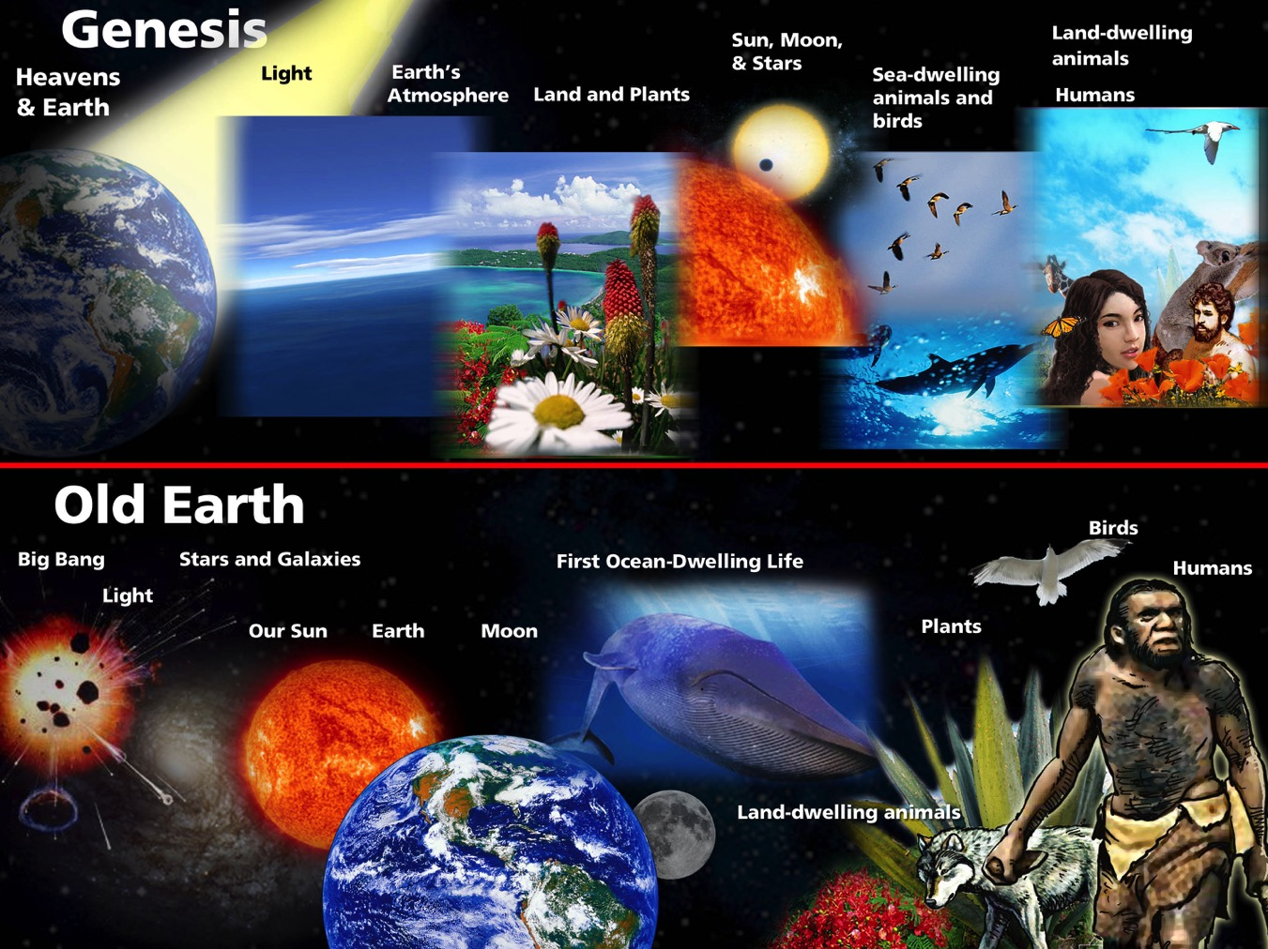
Old Earth/Young Earth Time Line
Jonathan Chong working on graphic
Notes:
Here's the next problem. The proponents of this theory say that Genesis is simply giving us a general understanding of the events, not a day-by-day account.
Look at this graphic. On the top is the order of events that we get from Genesis. On the bottom is the order of events based on an old-age scenario. In Genesis, the earth was created on day 1. Yet in the old-earth scenario, the earth doesn't come until much later. In the old-earth model the sun was created long before the earth, but in Genesis, it wasn't made until day 4. So these two models are completely out of sync.
The question is, are these day long periods of time? I would say “no.” But I suppose– like my Protracted Resurrection Theory– that we could tweak the days until we stretch them out to long periods of time. But again the question is why? Why do we need to reinterpret these days to be long periods of time?

Slide 11
Notes:
Before we talk about the final place in which we can insert the layers and fossils, there's one more gargantuan problem I want to point out with trying to fit the long ages before or during creation week. In any old-earth scenario there would be animals living and dying millions of years before Adam and Eve even came on the scene.

Slide 12
God saw all that he had made, and it was very good. And there was evening, and there was morning—the sixth day.
- Genesis 1:31 NIV
Notes:
But look at what God said about His finished creation in verse 31 of chapter 1. “And God saw every thing that he had made, and, behold, it was very good. And the evening and the morning were the sixth day.”

Slide 13
Notes:
Think about this: millions of years of animals ripping each other apart, killing one another, and eating each other. And then we get to the end of creation week, and the Creator pronounces all of the death, pain, and gore as “very good”?

Slide 14
But if…
Notes:
But it gets worse. If animals lived and died before Adam, then we have the biggest theological problem of all! This means that death existed before mankind sinned. And this is in direct contradiction to the rest of the Bible that says death is a result of sin.

Slide 15
"… sin entered the world through one man, and death through sin, and in this way death came to all men, because all sinned."
- Romans 5:12 NIV
Notes:
Romans 5:12 says… But if we say there were millions of years of death before man even existed, then death can no longer be the result of man's rebellion. Instead death becomes a natural part of God's creation – something that God calls “very good.”
Jesus came to conquer death and pay our debt of sin. But if death was just a part of “very good creation” and not a penalty for sin, Christ's death did not conquer sin. So, the old earth claim that death is not the result of sin absolutely wipes out Christ's work on the cross!

Slide 16
For the creation was subjected to frustration, not by its own choice, but by the will of the one who subjected it, in hope ²¹that the creation itself will be liberated from its bondage to decay and brought into the glorious freedom of the children of God. ²²We know that the whole creation has been groaning as in the pains of childbirth right up to the present time.
- Romans 8:20-22
Notes:
To hold to an old earth, some have tried to get around the problem of death by saying that animal death doesn't count. But the Bible in Romans 8:20-22 tells us that man's rebellion affected the entire creation, including animals. [Read verses]

Slide 17
Notes:
Another way to get around this problem is to claim that only spiritual death is the result of sin--that physical death is natural. To that I have two simple questions. If Adam and Eve where supposed to live forever, and they are now dead, what killed them? Secondly, why did Christ have to die a physical death? To get around these questions, one must do a lot of theological patch-jobs.
This is why young-earth creationists are willing to draw a line in the sand over this issue. If you truly add long periods of time before or during creation week, it causes huge theological problems – even wiping out the meaning of sin, death, and Christ's very reason for dying on the cross. And again the question is why? Why do we have to try to do so many theological and scriptural gymnastics to hold to the old-earth idea?

Slide 18
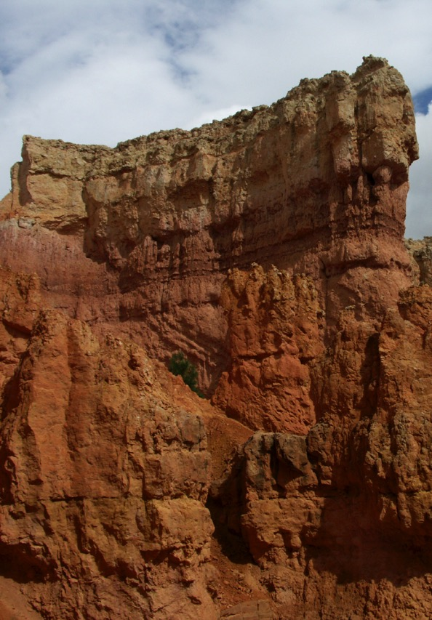
Uniformitarian
Catastrophism
Layers form gradually, one at a time over long periods of time.
Layers laid down one right after another in a short time as a result of catastrophe.
Notes:
So, if the geologic layers and the fossils don't fit before or during the creation week, where can we fit them in a biblical timeframe? Most geologists will agree that many of the large rock layers were deposited in water-related conditions. Further, to deposit the fossil record, we would need to kill millions of animals and quickly deposit them in wet sediments. Is there a biblical explanation for this? [wait for the audience to answer]. That's right, the worldwide flood!
There is a vast blanket of sedimentary rock layers that stretches over most of North America, and almost every continent. It contains marine fossils, which indicates that the oceans were over the continents at one time.
Now there are different ways to interpret these sedimentary rock layers. The standard way is known as the uniformitarian way. A uniformitarian geologist looks at the current rates, and calculates backwards to find out the age. For example, if one layer accumulates per year and there are a million layers, we might assume that it took a million years for the whole sequence to form.
On the other hand, a catastrophist geologist says that most of the geologic record was not deposited slowly and gradually, but is actually the results of catastrophic events---that a large amount of geologic work was done in a short period of time.

Slide 19
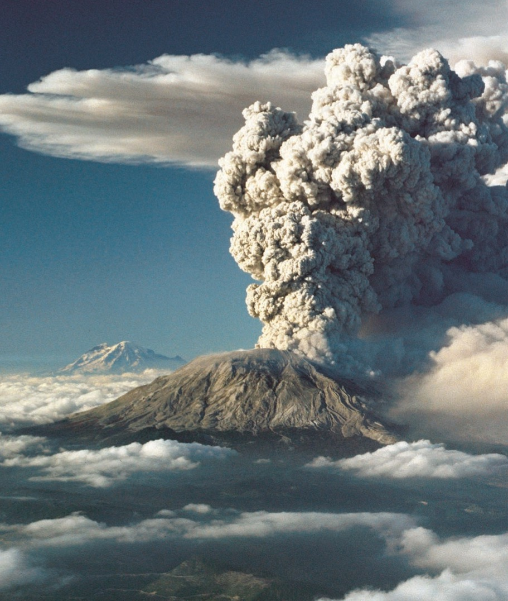
Mount St. Helens
Photo courtesy of USGS
Notes:
So who's right? Let's look at Mount St. Helens. On May 18, 1980, God set up the lab for us – the eruption of Mount St. Helens! The total energy output on May 18 was equivalent to 400 million tons of TNT--approximately 30,000 Hiroshima-size atomic bombs.

Slide 20
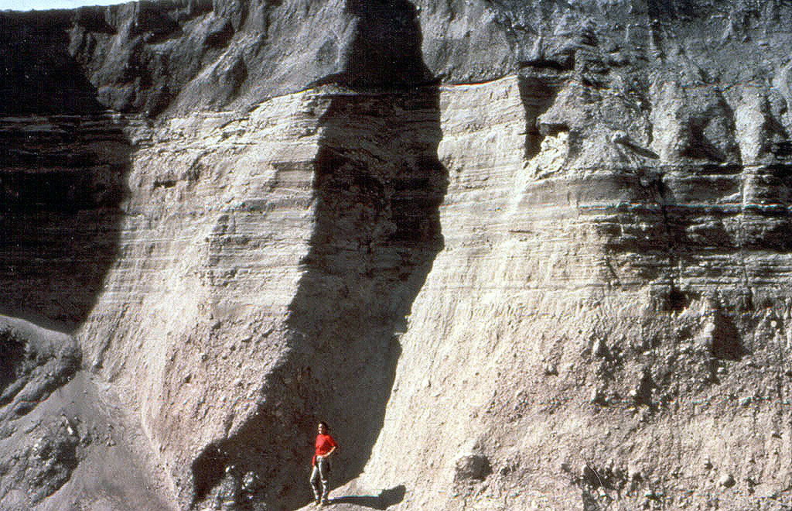
200 layers in 3 hours!
Notes:
During the eruption, the largest landslide ever captured on film deposited one-half cubic mile of rock and ice north of the volcano. Then in June of that same year, the mountain erupted again, this time with powerful pyroclastic flows. These flows were high-speed slurries of broken rocks, pumice, and ash -- all suspended in super-heated gases. As it blasted down the mountain the gas began to dissipate, and the material began skipping along the ground, sorting itself as it formed 200 distinct layers in less than three hours! And while this was the result of materials suspended in gasses, scientists now know these same physics apply to water dynamics. When we look at the layering left behind, it reminds us of sedimentary rock layers in the Grand Canyon, which have been previously thought to be formed over a very long time as the layers gradually collected.

Slide 21
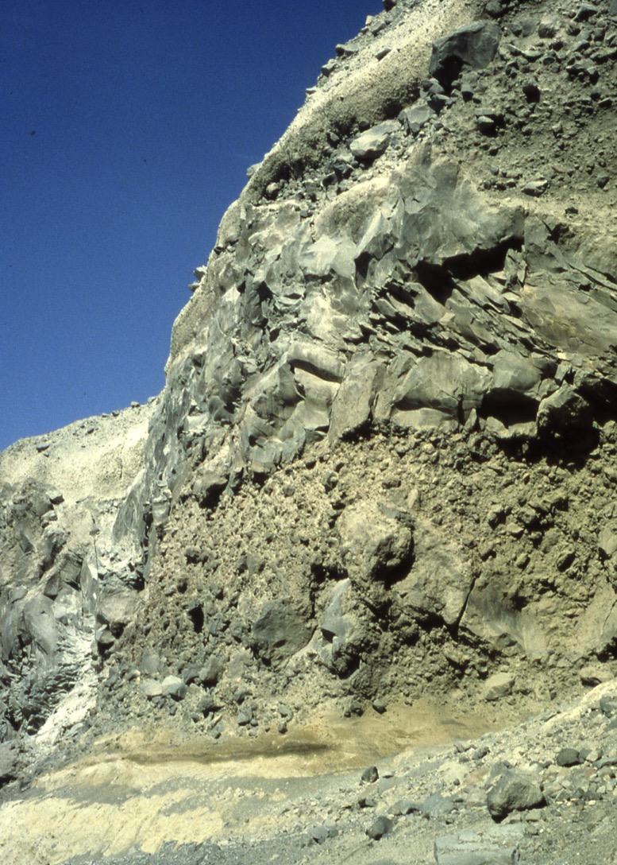
Step Canyon & Loowit Canyon
Notes:
Another thing we learned about from Mount St. Helens was rapid erosion. Up on the mountain there is a place called Step Canyon. In the five months following the eruption this canyon was formed by mud and pyroclastic flows. This canyon is up to 700' deep. To its east is Loowit Canyon. Both canyons cut through 100' of solid rock and there are now creeks flowing through each canyon. Again, if we had not been there to see it, many would now claim that these canyons took a very long time to form. And yet we watched it happen in a few months!

Slide 22
There are two ways to explain most of the fossils we find...
Old Earth Model
Millions of extraordinary events over millions of years have made the millions of fossils we find.
Flood Model
One huge water catastrophe killed millions of animals at the same time and buried them in mud.
Notes:
Let's talk very quickly about fossils. When an animal dies, it often decays or is eaten by predators. In order to become a fossil, something extraordinary must happen to preserve the animal remains! One good way would be to bury its remains rapidly and deeply. Then minerals can penetrate the animal's body. For example, cells may be replaced or impregnated with silica. So there are two different ways to explain why we've found millions of fossils.
Old-Earth Scenario. On one hand we can say that there have been millions of extraordinary events over millions of years that have created the millions of fossils that we've discovered.
Young-Earth Scenario. On the other hand, we could say that there was one catastrophic event that killed millions of animals, rapidly covering them in sediment and causing quick fossilization.

Slide 23
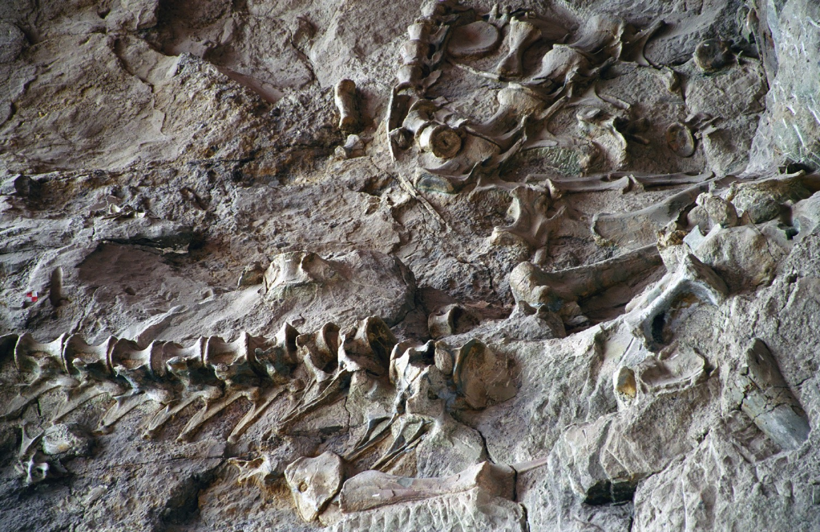
Notes:
So which one is most convincing? What we find all around the world is mass-kill graveyards. For example, this is Dinosaur National Monument in Utah. They have found thousands of dinosaur fossils mixed with marine fossils. And this is the kind of thing we see all around the world – thousands of animals killed by large amounts of water and buried rapidly by large amounts of sediment. This is exactly what we'd expect to see if there was a worldwide flood!

Slide 24
Notes:
So the evidence fits well with placing the layers and fossils during Noah's Flood. But some of you are saying, “Look, I believe the literal Genesis, but just accept that the earth is old like science says.” Okay, but here's the problem--you have to put those millions of years somewhere. What about after creation week, but before the Flood? No, that can't work either because the Bible starts recording genealogies from Adam to Christ. While there may be a way to stretch these genealogies out, the max would only be several thousand years. So in the end there are only three options. The first two require major theological stunts and do not best fit the evidence from the geological and fossil record. The third option fits the layers and fossils, and is based on a plain reading of the Scriptures.
Wimpy flood. I should also point out that to hold to an old earth you must reject the idea that the Flood did any real damage. We must either attribute the geologic layers and fossils to millions of years or to the worldwide Flood. So if you hold to the old-earth scenario, you have a wimpy flood that left no evidence whatsoever of the Lord's wrath and judgment on the world!

Slide 25
… Let God be true, and every man a liar. As it is written:
“So that you may be proved right when you speak
and prevail when you judge.”
- Romans 3:4
Notes:
So if the third option is in agreement with the plain meaning of the Bible, and even explains the geologic ages and fossil record, why hold to the old earth? And here is the answer: Christians have been convinced that science has proven the earth old. So we don't want to look foolish, or outdated. But why would we ever use man's fallible human ideas to interpret God's inerrant and perfect word of God? Romans 3:4 says, “God forbid: yea, let God be true, but every man a liar; as it is written, That thou mightest be justified in thy sayings, and mightest overcome when thou art judged.”
I'm guessing there are some people right now in this audience who feel a large weight being taken off their shoulders. They've wanted to just believe Genesis as it is, but felt a burden to fit it with man's ideas and theories. Take the burden off—be free. Read God's Word and just accept it as is!
In my opinion this is where this talk could end. God's Word says it, that settles it. If Genesis says six days, then it's six days. But Christians have been intimidated by science, so I want to spend just a few minutes looking at the scientific evidence.

Slide 26
“I estimate that there are probably several hundred processes that one could use to get an idea of the age of the earth. Only a few dozen, at most, of these processes seem to give you billions of years. The other 90 per cent of those processes give you ages much less than billions of years.”
- Dr. Russell Humphreys
Notes:
There is a physicist named Dr. Russell Humphreys who has received many scientific honors and awards. He also worked for many years on the Particle Beam Fusion project and many others at Sandia National Laboratories in Albuquerque, New Mexico. This work involved geophysics and nuclear physics, both theoretical and experimental. He says, “I estimate that there are probably several hundred processes that one could use to get an idea of the age of the earth. Only a few dozen, at most, of these processes seem to give you billions of years. The other 90 per cent of those processes give you ages much less than billions of years.” So let's take a very quick look at some of these processes.

Slide 27
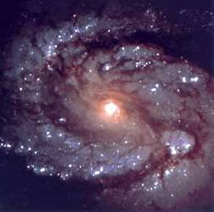
Galaxies wind themselves up too fast.
Supposed to be 10 billion years old
Less than a few hundred million years old.
Notes:
First are galaxies, like our own Milky Way. We've observed that they rotate. The stars on the inside are moving much faster than those on the outside. If our galaxy – or others – were more than a few hundred million years old, they should be discs of featureless stars. But instead we still have very distinct arms. In an old-age model, the Milky Way should be at least 10 billion years old. A few hundred million years falls orders of magnitude below the time the old-earth theory needs. This upper limit destroys the age needed. But it's not a problem for us; 6,000 years falls easily under the upper limit of hundreds of millions of years. We don't know how wound-up our galaxy was when it began. No problem.

Slide 28
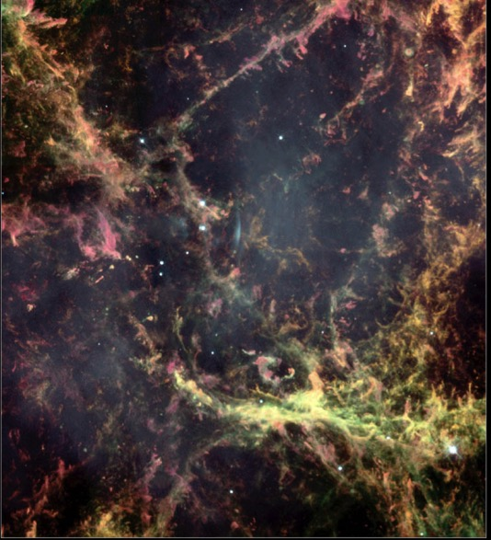
Not enough supernova remnants
Only 200 remnants seen in our galaxy: only 7,000-14,000 years worth
Notes:
Here's another one. We've observed that galaxies like ours experience a supernova about every 25 years. Now when these stars violently explode like this, they leave behind gas and dust remnants that will remain visible for over a million years. When we observe these remnants, we've only been able to discover about 200 in our galaxy. That's consistent with 7,000 years worth of supernovae!

Slide 29
Seafloor mud accumulates too fast.
Mud entering: 20 billion tons per year
Ocean
Mud: 400 meters
Continent
Subducting Plate
Mud leaving: 1 billion tons per year
Max age: 12 million years
Notes:
Another process is the erosion of the continents. Each year wind and water erode about 20 billion tons of rock and dirt and dumps this erosion into the seas. Now about one billion tons are removed as a result of plate tectonics – for a grand total of 19 billion tons that accumulates annually. This erosion has formed a layer averaging about 400 meters deep for the entire ocean. At this rate a 400 meter layer should form in about 12 million years. Yet, according to old-earth scenarios, this erosion has been happening for over 3 billion years! Again the observed rate is far below the old-earth model. However, a worldwide flood would be a very plausible mechanism for providing more than enough erosion to account for what we see.

Slide 30
The sea is not salty enough.
Sodium in: 450 million tons per year
Out: 27% per year
Max age: 42 million years
Notes:
Along the same lines, every year rivers and other sources dump over 450 million tons of sodium into the ocean. Other natural processes remove about 27% of that salt each year. Using these numbers, if the ocean had no sodium to start with, it would have accumulated its present amount in less than 62 million years [slide text says 42 million years :-]. Again, this falls magnitudes below that needed for the old-age scenario of 3 billion years. But because the Genesis Flood would deposit much sodium into the ocean, it's not a problem in the young-earth model.

Slide 31
The Earth's magnetic field is losing energy too fast.
Loses half its energy every 1,454 years
Lost energy faster during reversals in Genesis Flood
Max age: 20,000 years
Notes:
The energy in earth's magnetic field is decreasing fast--roughly by half every 1,400 years. Old-earth scientists have had to invent many theories to explain such a rapid deterioration and how this magnetic field could have lasted for their assumed long ages. But those theories are very inadequate to solve the problem. Creationists have produced a theory that matches the historic data and present figures. It shows that the earth's magnetic field could not have survived more than 20,000 years--largely short of the supposed 4.6 billion year-old age of the earth.

Slide 32
Biological material decays too fast.
T-Rex fossils are supposedly 65 million years old!
Max age: 10,000 years
Notes:
DNA and biological material is very fragile. Not too long ago, scientists were claiming that this type of material could only last 10,000 years if left even in the best possible natural environments. And yet we've all heard about the recent discoveries of dinosaur fossils that still contain DNA and soft-tissues. We've also found DNA in Neanderthal fossils and insects preserved in amber. These discoveries are impossible to explain in an old-earth scenario, but again no problem in the young-earth model.

Slide 33
Agriculture is too short.
Appearance of man
10,000 years ago man begins to farm
185,000 years before man learns to grow plants?
Notes:
This brings us to another problem. In the old-earth scenario, farming only began about 10,000 years ago. Yet the Stone Age is supposed to have lasted 185,000 years. So over 8 billion people used tools for thousands of generations and never once did anyone figure out that plants grow from seeds. This just seems incorrect.

Slide 34
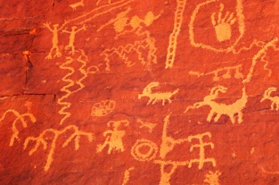
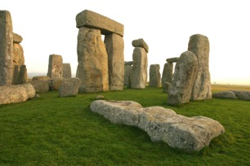
Written history is too short.
Appearance of man
4,000 to 5,000 years ago man begins to record history
190,000 years before man learns to record history?
Notes:
This is related to the last problem. According to old-earth theory, mankind existed for 190,000 years before beginning to make written records about 4,000 to 5,000 years ago. Yet “primitive” man built megalithic monuments, made cave paintings, and kept records of lunar phases. Why would he wait almost 200,000 years to record history? You see, the times just do not add up in an old-earth scenario!

Slide 35
Uranium decays into lead
Radioisotope Dating
The 3 assumptions of radioisotope dating:
Original Composition
of the Rock
Constant Rate
No Contamination
Uranium
Decays over time
Lead
Notes:
I've briefly touched on just a few of the possible physical indicators of the age of the earth; there are several hundred! But now, what about the other 10% of processes that do yield long ages?
A large part of that 10% percent is radioisotope dating. This is THE way in which we have obtained the old ages for the earth.
First, let me explain how radioisotope dating works. Some rocks contain radioactive elements that slowly break down into other materials. For example, uranium in a rock slowly decays into lead. If we know the rate at which this decay happens, then we should be able to determine the age of the rock by the amounts of remaining uranium and lead. Now uranium/lead is just one type of radioisotope dating. There are other elements that we can use in a similar way. But the basic idea is that a parent element will slowly decay into a daughter element.
But there are three major assumptions that go into this method of dating:
Original Composition of the rock. The first assumption is that we know how much of the parent and daughter elements were present in the rock to begin with.
Constant Rate. The second assumption is that the rate of decay is constant.
No Contamination. The final assumption is that the rock was never contaminated.

Slide 36
Mount St. Helens
Notes:
Dr. Steve Austin, a geologist from the Institute for Creation Research, pulled a sample from the lava dome at Mount St. Helens in 1992. At the time, the rock was less than 15 years old. He sent it to Geochron, a much respected lab. They dated components of the rock as well as a whole rock as a unit. The dates ranged from 350,000 to 2.4 million years old! And this is just one of many measurements that have shown similar results. So for a long time creationists have been able to point out that radioisotope dating is not accurate, but it wasn't until recently that they could scientifically show why it doesn't work!

Slide 37
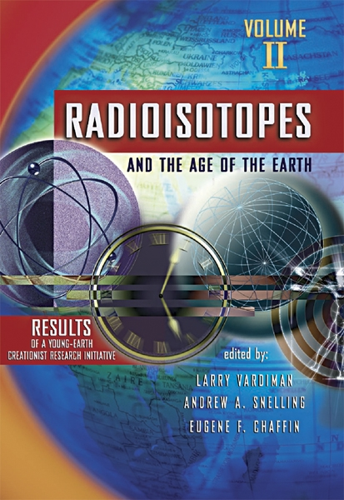
Radioisotopes
Inconsistent dates
Left-over helium
Radiohalos
Carbon found in “ancient” diamonds
Notes:
In 2005 the Institute for Creation Research released the exciting results of an eight-year research project called RATE, which stands for Radioisotopes and the Age of the Earth. Here are just a few things that they discovered:
Inconsistent Dates. Conventional radioisotope dating methods are inconsistent and therefore not reliable. Dating the same rock layer four times yielded four different ages!
Left-over helium. Substantial amounts of helium were foundRadio in crystals within granite. If the earth evolved over billions of years, all the helium should have already escaped.
Radiohalos. Radiohalos, caused by the decay of uranium and polonium, were found in rocks, which strongly suggests a rapid decay rate, not gradual decay over billions of years.
Carbon in “ancient” diamonds. Diamonds thought to be millions/billions of years old contain significant levels of carbon-14. Since carbon-14 decays quickly, none should have been found in the diamonds if the old age is correct.
The body of research that's come out of RATE is huge – there's no way to do it justice in a short time like this. But listen! Radioisotope dating has been the main tool used to show the earth to be old, and it has just been invalidated by scientific research. Radioisotope dating made up the majority of the 10% that has been misunderstood to support an old earth!

Slide 38
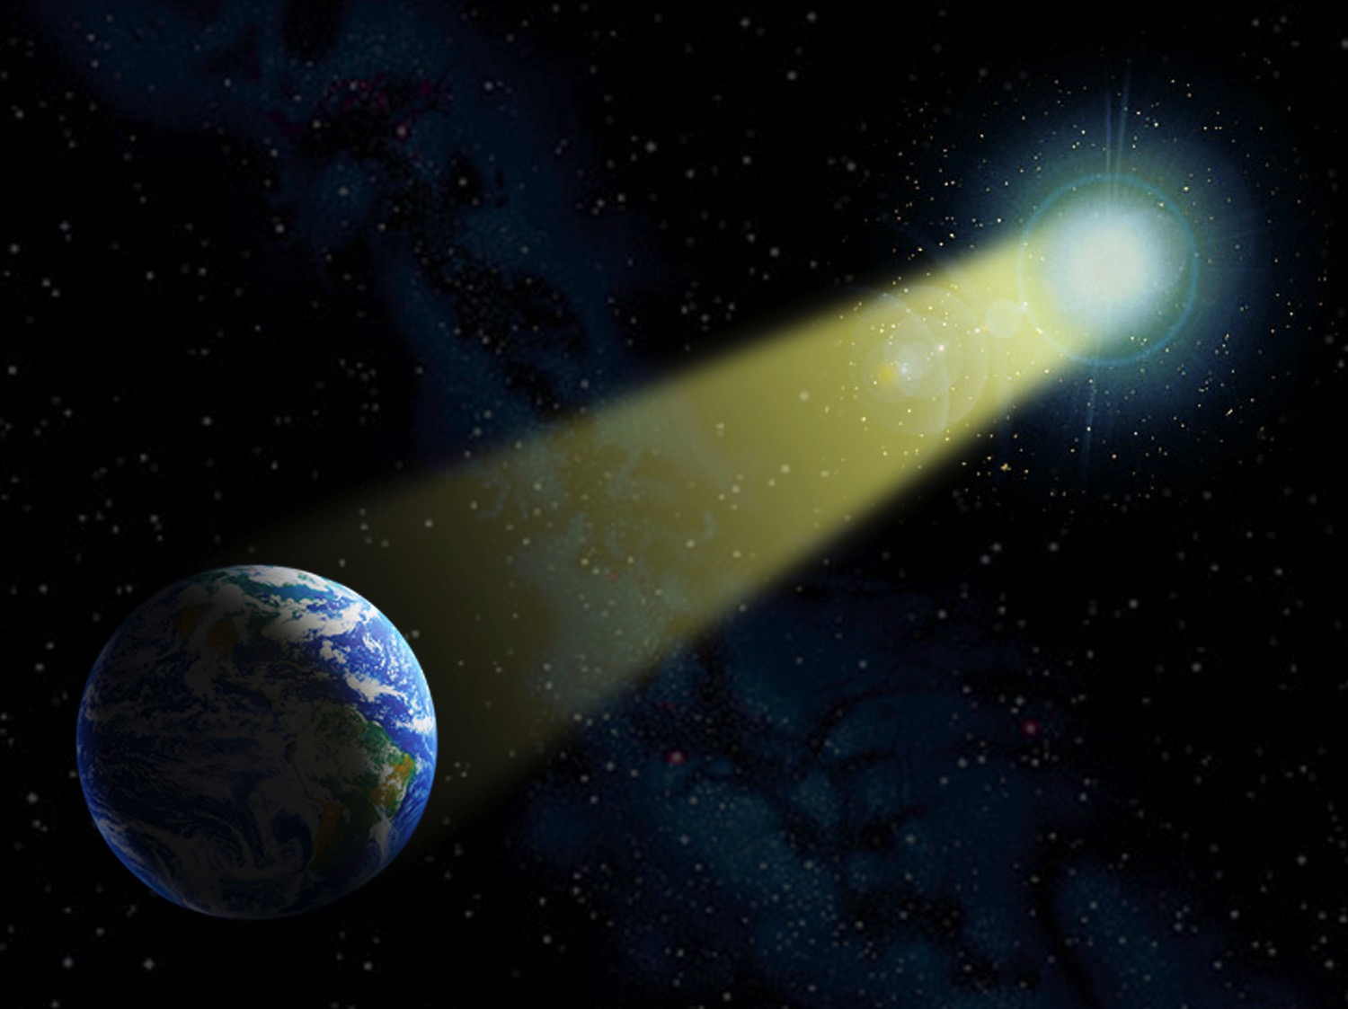
Distant Starlight
Notes:
There's another matter that also fits into that 10%. It's distant starlight. I want to be honest -- this is an issue which still needs to be understood. The problem is of course that we are receiving starlight from stars that are millions of light-years away. If the universe is young, how can we explain this? I have three answers to that question:

Slide 39
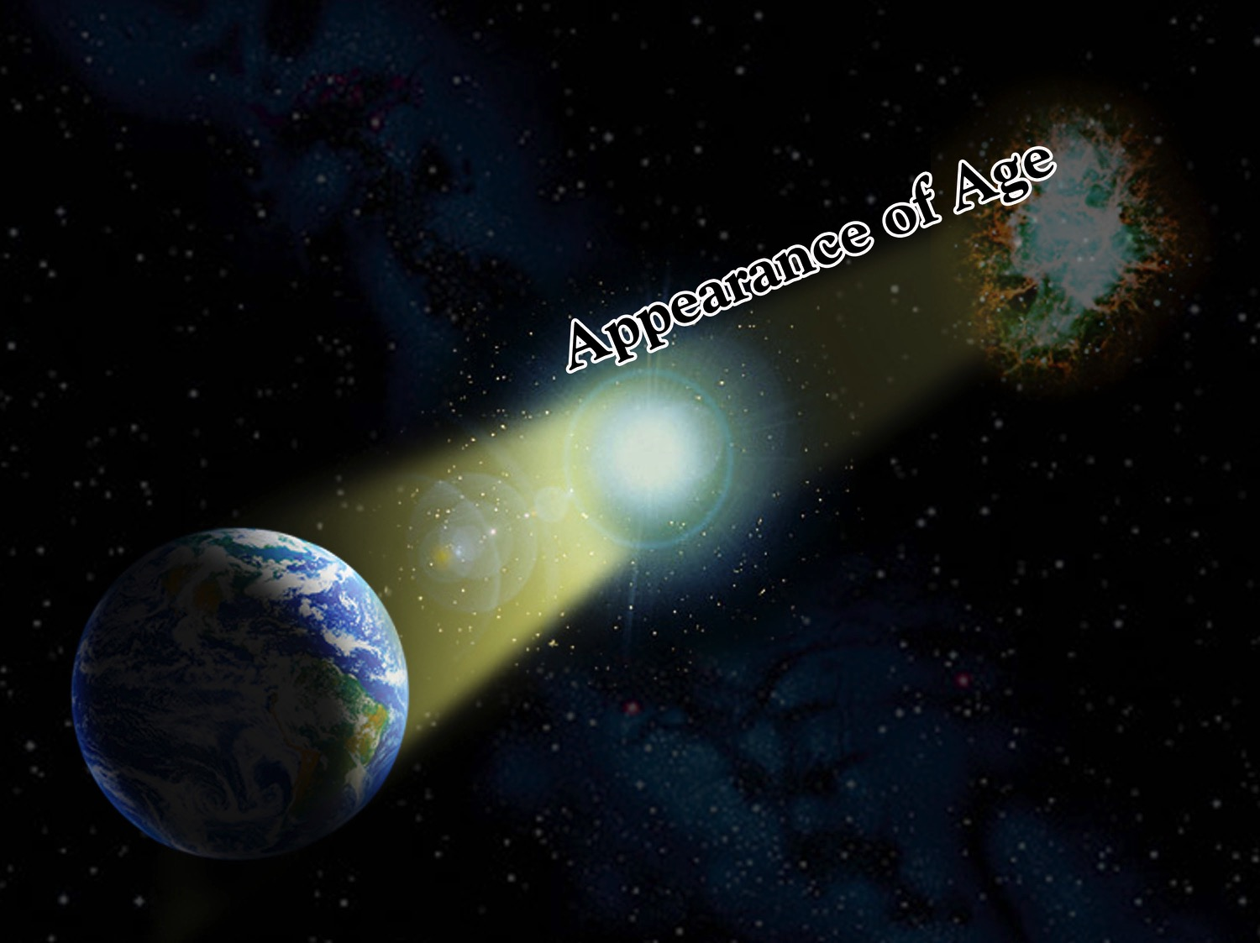
Notes:
Could it be that God simply created the stars and their light already arriving on earth on day 4 of creation week? The problem is when we see a star several million light-years away go supernova, yet the light is just now reaching the earth. Since that light would've had to leave the supernova millions of years before the universe was even created, we are seeing a star that never existed. So the objection is that God created false histories in the starlight.

Slide 40
Notes:
But let me ask you a question. Do you believe that Eve was created with hair? If so, then you have the same problem, because hair is made up of little platelets of proteins. By looking at someone's hair you can determine his or her nutritional history. So on day 6 of creation, if we could've plucked a hair from Eve's head, we would've seen a history that never happened – just like the starlight. Is God deceiving us? No. Eve must've looked older than her one day of life. The plants growing must've looked like they had been growing for years. God created this world already functioning, and that, by definition, is creation out of nothing. He did not deceive us, because He has told us plainly what He did. So “appearance of age” is one possible answer.

Slide 41
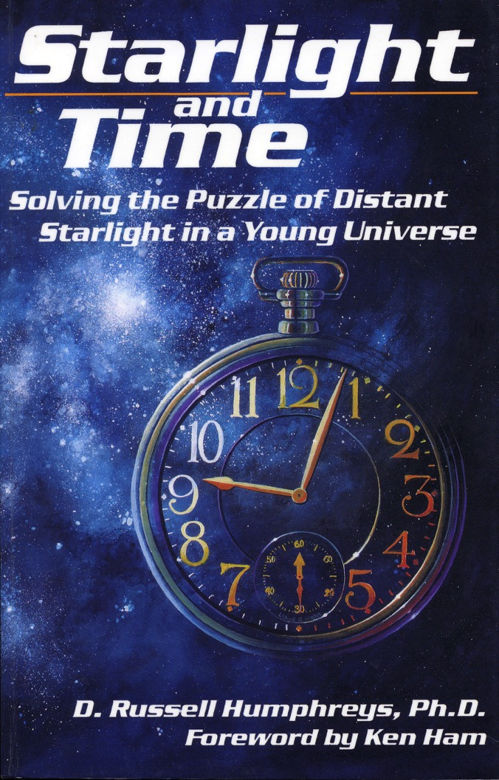
Notes:
Several creationists, including Dr. Russ Humphreys, have presented several promising solutions to the problem of starlight. Dr. Humphreys' idea is asserted in his book Starlight and Time. His theory is based on known laws of physics and Einstein's theory of relativity. The mathematics allows time to flow faster and faster as you get further from the center of the universe. Dr. Humphreys' theory can actually explain how the stars could be created during one ordinary day --- day four -- and yet have the starlight reaching earth by day six.
We may not yet have the solution for distant starlight. But that's okay, we're just humans trying to understand God's universe, and there are things that we just don't understand yet.
But let me just point out that not so long ago, fossils were a big problem for the young-earth model because they were supposedly formed over millions of years. But now fossils are one of our best friends, clearly demonstrating evidence for the worldwide Flood. So, I'm wondering if the same thing may someday be true with the distant starlight problem.

Slide 42
A Working Strategy
“So it seems like it would be good science to go with the flow of the 90% of the data, and use as a working hypothesis that the Earth really is young and then try to find explanations for the other 10% of the data. That whole process seems to be a much more scientific approach than the one that is taken by evolutionists. Basically, they concentrate on the 10% of the data, and that's the data you've always heard about.”
- Dr. Russell Humphreys
Notes:
If 90-plus percent of the evidence clearly shows the earth to be young, do we throw that out because we don't understand starlight? Let me again quote Dr. Humphreys. “So it seems like it would be good science to go with the flow of the 90 per cent of the data, and use as a working hypothesis that the Earth really is young and then to try to find explanations for the other 10% of the data. That whole process seems to be a much more scientific approach than the one that is taken by evolutionists. Basically, they concentrate on the 10% of the data, and that's the data you've always heard about.” So not only does the Bible plainly teach a young earth, but science is in agreement.

Slide 43
“But, Billy, it's simply not possible any longer to believe, for instance, the biblical account of creation. The world wasn't created over a period of days a few thousand years ago; it has evolved over millions of years. It's not a matter of speculation; it's demonstrable fact.”
- Charles Templeton
Notes:
Back in the 40s, hundreds of people would gather to hear a young evangelist preach. They say there were 150 converts a night. In 1946, the National Association of Evangelicals named Charles Templeton as “one of those best used by God.” He started a church in Toronto, served as vice-president for Youth for Christ International, and had even become better known for his evangelism than his friend Billy Graham. But then something began to change in Templeton's life. He began to question the age of the earth. He struggled with the claims of science and began to believe that the plain teaching of Scriptures were in conflict with real facts. In a conversation with Billy Graham, Mr. Templeton once said, “But, Billy, its simply not possible any longer to believe, for instance, the biblical account of creation. The world wasn't created over a period of days a few thousand tears ago; it has evolved over millions of years. It's not a matter of speculation; it's demonstrable fact.” From this point Templeton began to pull out of ministry, looking for unresolved answers to his scientific questions.

Slide 44
“I believe that there is no supreme being with human attributes—no God in the biblical sense—but that all life is the result of timeless evolutionary forces… over millions of years.”
- Charles Templeton
Notes:
By 1996 he had completed his descent into unbelief when he published a book titled Farewell to God. In that book he wrote, “I believe that there is no supreme being with human attributes – no God in the biblical sense – but that all life is the result of timeless evolutionary forces… over millions of years.” Rejecting the plain reading of Genesis, and the young age of the earth was what lead one of the most powerful evangelists on a journey that ended with complete disbelief in the Creator and His Word. And sadly, this continues today. Thousands upon thousands of Christians have become the casualties of doubting God. They continue to believe Satan's original lie, “Is it true what God has said?”
And that is why we must draw a line in the sand. Are you willing to join the battle for truth?

Slide 45
Finally, be strong in the Lord and in his mighty power. ¹¹Put on the full armor of God so that you can take your stand against the devil’s schemes. ¹²For our struggle is not against flesh and blood, but against the rulers, against the authorities, against the powers of this dark world and against the spiritual forces of evil in the heavenly realms. ¹³Therefore put on the full armor of God, so that when the day of evil comes, you may be able to stand your ground, and after you have done everything, to stand. ¹⁴Stand firm then, with the belt of truth buckled around your waist, with the breastplate of righteousness in place, ¹⁵and with your feet fitted with the readiness that comes from the gospel of peace.
Ephesians 6:10-15
Notes:
The Scriptures state in Ephesians 6, “Finally, my brethren, be strong in the Lord, and in the power of his might. Put on the whole armor of God, that ye may be able to stand against the wiles of the devil. For we wrestle not against flesh and blood, but against principalities, against powers, against the rulers of the darkness of this world, against spiritual wickedness in high places. Wherefore take unto you the whole armor of God, that you may be able to withstand in the evil day, and having done all, to stand. Stand therefore, having your loins girt about with truth, and having on the breastplate of righteousness; And your feet shod with the preparation of the gospel of peace;”

Slide 46
In addition to all this, take up the shield of faith, with which you can extinguish all the flaming arrows of the evil one. ¹⁷Take the helmet of salvation and the sword of the Spirit, which is the word of God. ¹⁸And pray in the Spirit on all occasions with all kinds of prayers and requests. With this in mind, be alert and always keep on praying for all the saints.
¹⁹Pray also for me, that whenever I open my mouth, words may be given me so that I will fearlessly make known the mystery of the gospel, ²⁰for which I am an ambassador in chains. Pray that I may declare it fearlessly, as I should.
Ephesians 6:16-20
Notes:
“Above all, taking the shield of faith, wherewith ye shall be able to quench all the fiery darts of the wicked. And take the helmet of salvation and the sword of the Spirit, which is the word of God: Praying always with all prayer and supplication in the Spirit, and watching thereunto with all perseverance and supplication for all saints; And for me, that utterance may be given unto me, that I may open my mouth boldly, to make known the mystery of the gospel, For which I am an ambassador in bonds; that therein I may speak boldly, as I ought to speak.”

Slide 47
Black

Slide 48
Creation link at BibleStudyDownloads.org
Get this presentation for free!
Notes:
Creation (cr)

